Slide 1
MIS 407
Week 1, Class 2
Prof. Smith
timsmith@iastate.edu

Slide 2
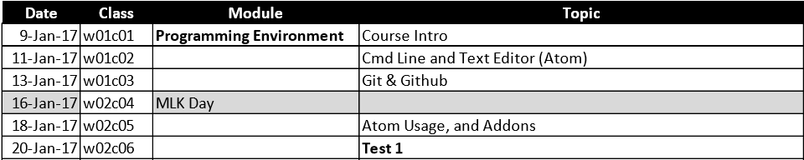
For Today…
Goals:
Recap: You should be set up with Slack and GitHub
Introduce the terms terminal, console, command shell, prompt, command line (and history)
Cover the basic Bash shell commands
Provide you with links to advanced Bash Shell Programming (optional)
Intro Atom, our text editor.
Conduct our first in-class assignment ICA01

Slide 3
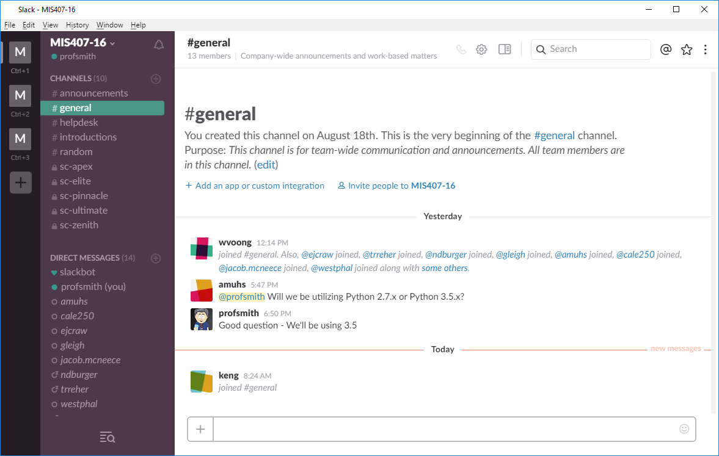
Let’s all get Slack…

Slide 4
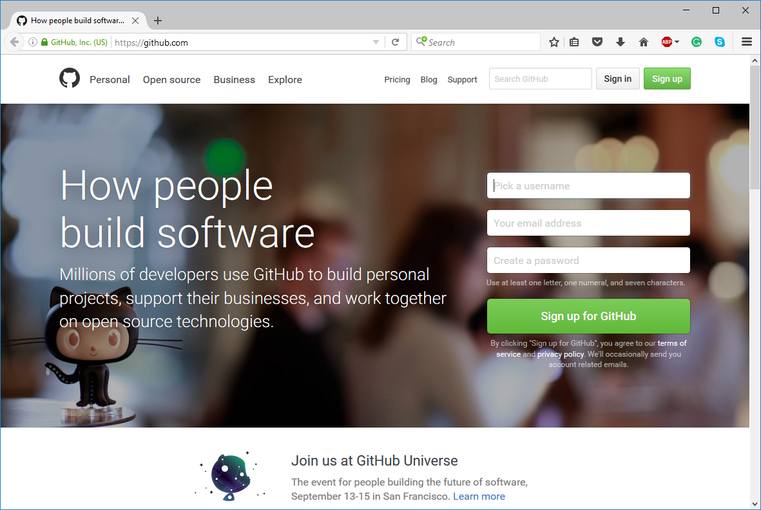
Get your GitHub account!
If you haven’t already done so You must create your account, and send me your username ASAP!

Slide 5
Now, for an intro to Bash and Atom…

Slide 6
By next class…
Create a GitHub account, and email me (timsmith@iastate.edu) and cc our TA (sunil@iastate.edu) your userID
Join our MIS407 “Slack” team and introduce yourself to the class and to your team. If you haven’t already received an invitation, please contact our TA.
Familiarize yourself with Git (note, this is not the same as GitHub, we’ll discuss this next class).
Read sections 1.1 through 1.3 of the book ProGit found here - https://git-scm.com/book/en/v2
During Next class…
We’ll being working with Git and GitHub, therefore it’s very important that you have your GitHub account created, and that you have sent myself and the TA a copy of your user ID (to be properly assed to our GitHub site, you will need to have this to us by Thursday 8PM).

